Slide 1
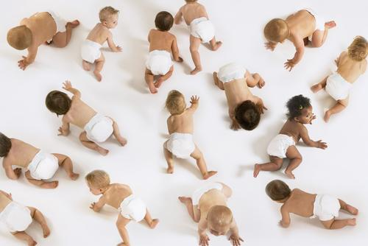
The Man Who Saved a Thousand Babies
by Lauren Tarshis
***As you read, think about: A hero is a person who is courageous, outstanding, or noble. In what way was Vivien Thomas a hero?

Slide 2
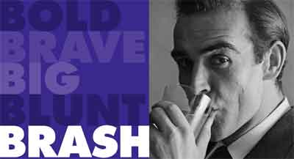
Preview Vocabulary
1. brash (BRASH) adjective; A brash person is confident and aggressive, sometimes in a rude or unpleasant way. For example, a brash reporter might offend a celebrity by asking too many personal questions during an interview.

Slide 3
Preview Vocabulary
2. cardiologist (kahr-dee-OL-uh-jist) noun; Cardiology is the study of the heart and diseases that affect the heart. A cardiologist is a doctor who specializes in the treatment of diseases related to the heart.

Slide 4
Preview Vocabulary
3. delicate (DEHL-ih-kit) adjective; Something that is delicate is easily damaged, usually because it is tiny, light, or thin. Flower petals, spiderwebs, and lace are delicate objects. But someone’s feelings can be delicate too, if they are easily hurt. An activity can be described as delicate if it is difficult and requires great skill and care to accomplish—in other words, if it can easily go wrong.

Slide 5
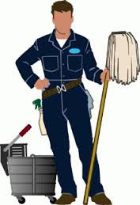
Preview Vocabulary
4. menial (MEE-nee-uhl) adjective; A menial task is one that requires little or no training or skill to complete. Washing dishes, sweeping the floor, and scrubbing the toilet are examples of menial tasks.

Slide 6
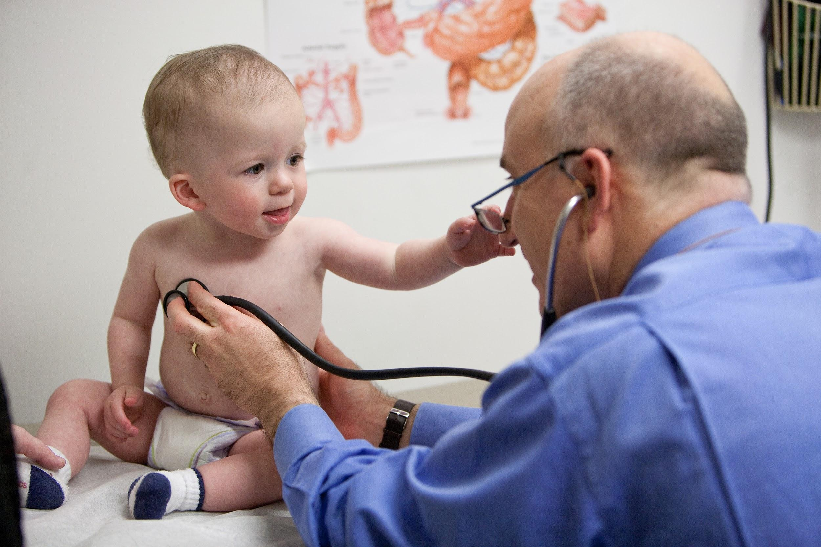
Preview Vocabulary
5. pediatric (pee-dee-A-trik) adjective; Pediatric is a medical word that means “related to the medical care or illnesses of babies and children.”

Slide 7
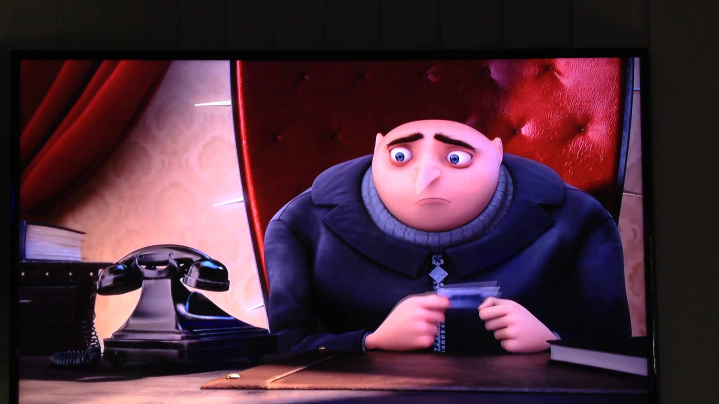
Preview Vocabulary
6. reluctance (reh-LUHK-tuhns) noun; The adjective reluctant means “feeling or showing doubt, hesitation, or unwillingness.” Reluctance is the state of being reluctant. If your little brother is afraid of the dark, he might express reluctance to go on a camping trip in the woods.

Slide 8
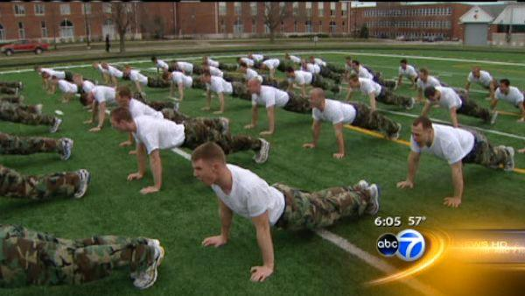
Preview Vocabulary
7. rigorous (RIG-er-uhs) adjective; Something that is rigorous is strict and demanding, and demands that the rules be closely followed. A doctor might put a patient on a rigorous diet and exercise program. If a school has rigorous standards, it has high standards and doesn’t allow any messing around—you are expected to meet those standards!

Slide 9
Essential Questions
Now, Let’s Read!
How do people overcome challenges?
How does prejudice affect society?
Why are some historical figures remembered better than others?

Slide 10
Exploring Text Structures
“Text structure” is the term for how an author organizes information. Authors use different text structures to achieve different purposes, and one piece of writing can often have multiple text structures.
Description or List Includes details to help you picture or get to know a person, a place, a thing, or an idea
Compare and Contrast Presents the similarities and/or differences between two items, such as a pair of events, time periods, ideas, or places
Cause and Effect Explains why something happened (cause) and what happened as a result (effect)
Problem and Solution Presents a problem and explains how it is solved
Sequence of Events Describes events in the order in which they happen (also called chronological order)

Slide 11
Team Talk (in “table voice”, please)
With your group, reread the selection and discuss the questions.
Challenge: Try to use your new vocabulary words in your discussion!
1. The article begins with the dramatic description of a dying baby. Why might Lauren Tarshis have started her story this way?
2. Vivien Thomas was not able to attend medical school. Many medical schools did not accept black students, and Thomas could not afford the schools that did. How did he overcome this challenge?
3. Tarshis writes that in the 1940s, heart surgery was seen as the “Mount Everest” of medicine. Explain the metaphor she is using. What does it help the reader understand about Thomas, Blalock, and Taussig?
4. How was Thomas’s life in the lab different from his life outside of it? How was it the same?

Slide 12
Team Talk (in “table voice”, please)
Critical Thinking Questions (5 minutes)
With your group, reread the selection and discuss the questions.
Challenge: Try to use your new vocabulary words in your discussion!
1. An unsung hero is someone who is not recognized for his or her achievements. How was Thomas an unsung hero?
2. Think about the kind of prejudice and racism that Thomas faced during his lifetime. How does this kind of discrimination affect society?

Slide 13
Essay Time...
Read: The U.S. Post Office is releasing a new postage stamp. It’s looking for a historical figure who overcame obstacles and contributed something important to society.
Think: A hero is a person who is courageous, outstanding, or noble. In what way was Vivien Thomas a hero?
Write: Write an essay arguing that Vivien Thomas should be on the new stamp.
Be sure to:
have a clearly stated central idea
use supporting evidence
have good organization and transitions
check grammar, spelling, and punctuation

