Slide 1
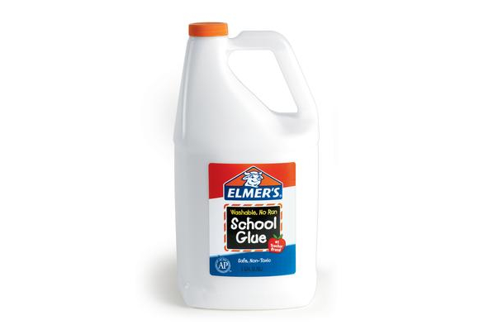
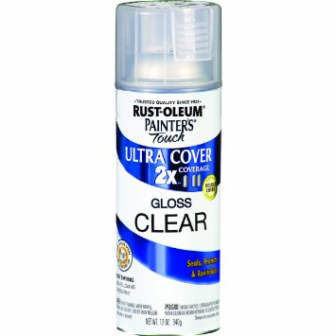
Materials Needed to Create a Journal
Each student will need the following supplies:
1 pre-cut manila folder ( I trimmed the edges off the folders to down-size the journals, but this is optional.)
1 pre-cut piece of brown butcher paper (Make sure that you cut the butcher paper large enough so that the file folder can be covered easily.)
2 cups of glue (small plastic cups) (School pre-ordered 5 gallons of glue= 140 students)
Napkins
Trash bag (Wrapping the desktops in trash bags makes for an easy clean up!)

Slide 2
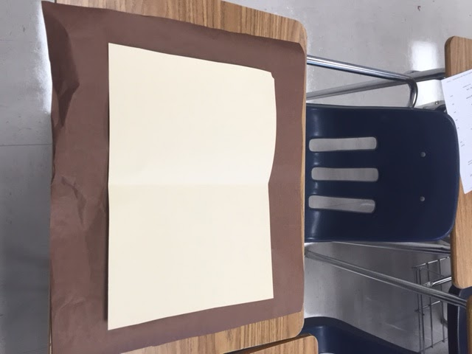
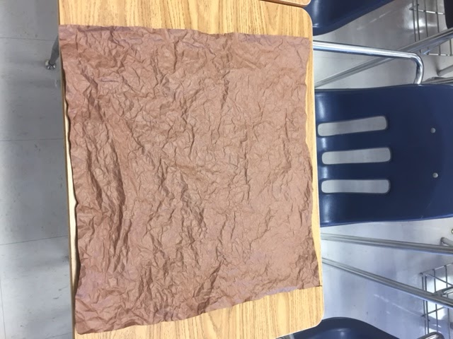
Creating a Journal
On the inside of your manilla folder, write your name across the middle. You may write largely because this will be covered once your folder is returned to you.
Using pre-cut brown butcher paper, crumble your piece of paper into a ball.
Open the ball of paper and smash back into a ball again. Continue this process until the paper is noticeably soft. The more times this process is followed, the softer the paper will appear and the more it will look like leather when the journal is complete.
Now, open the ball of paper and flatten it out on your desk. Try and smooth out all of the wrinkles The paper could be noticeably smaller. This is okay.
Name

Slide 3
Glue Rules
Stay in your seat.
Do not wipe glue on anything other than your paper.
All students will be allowed to wash their hands when it is time to clean up.

Slide 4
Glue Time
Pour one cup of glue onto your paper and spread it out with your fingers until all of the brown is covered. Do this quickly because the glue will begin to become tacky….
Now, lay your file folder on top of the paper and wrap your file folder neatly.
Finally, turn your file folder over so that you can pour the other cup of glue on the other side. Spread the glue to cover the dry brown paper.
This must dry overnight; therefore, prop your folder up like a teepee in the designated area.
The next day, the teacher will spray all journals with a clear coat of spray paint. This will dry within ten minutes and will give the journals an authentic leathery look. I would not skip this step. (140 students= 3 cans of clear coat)

Slide 5
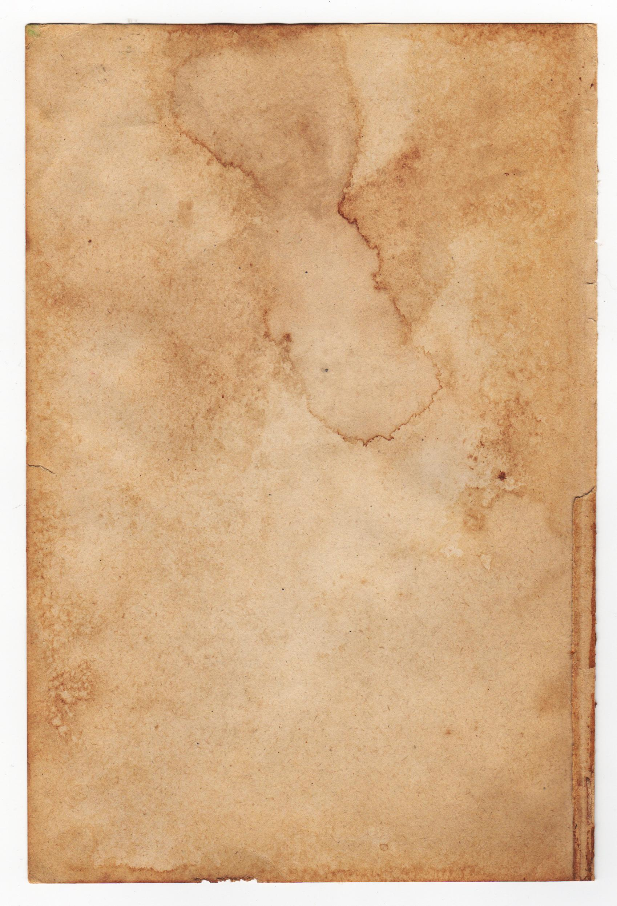
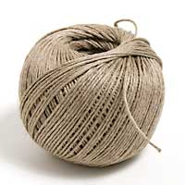
To Finish the Journal...
Paper will need to be added to your journal. You may prefer your paper to have an aged appearance. This may be achieved by using coffee or tea. Optional: bullet holes and blood stains
Tie with twine, leather, or ribbon.
Other personal touches maybe be added to the inside of the journal to cover the manilla folder.

Slide 6
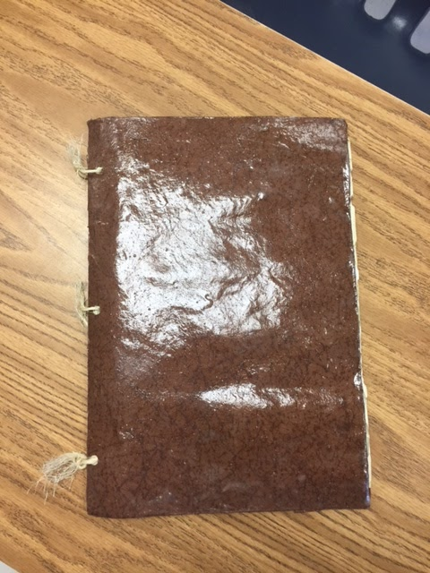
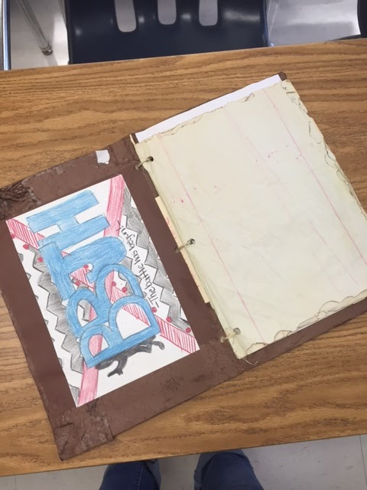
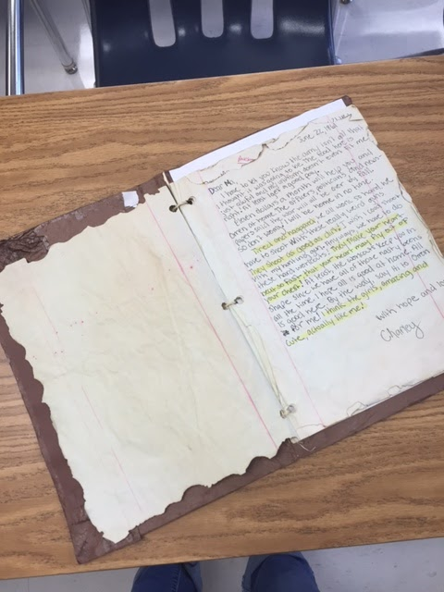
Faux Journal

