Slide 1
Word Choice...Author’s Craft…
Brush Strokes...
Left-side Title
Commas with Appositives
The definition of an appositive is a word or word group that defines or further identifies the noun or noun phrase preceding (before) it.
Rule: When an appositive is essential to the meaning of the noun it belongs to, don’t use commas. When the noun preceding the appositive provides sufficient identification on its own, use commas around the appositive.
Example: Jorge Torres, our senator, was born in California.
Explanation: Our senator is an appositive of the proper noun Jorge Torres. Our senator is surrounded by commas because Jorge Torres is a precise identifier.
Example: Our pediatrician, André Wilson, was born in California.
Explanation: Our pediatrician is still a relatively precise identifier so André Wilson is not considered essential.
Example: CEO Julie Minsky will be our featured speaker.
Explanation: Julie Minsky is necessary to help identify CEO, so no commas are used.
Example: Julie Minsky, CEO, will be our featured speaker.
Explanation: Julie Minsky is a precise identifier so the appositive is surrounded by commas.
Appositives

Slide 2
Word Choice...Author’s Craft…
Brush Strokes...
Left-side Title
Appositives

Slide 3
Word Choice...Author’s Craft…
Brush Strokes...
Right-side:
1. Start your sentence with Christina Grimmie, then rename the noun with a second noun such as artist, entertainer, performer, woman, or soloist. Use one of these examples or select a noun of your own and build an appositive phrase by adding a few descriptive words. Be sure to place a comma before and after your appositive.
Appositives

Slide 4
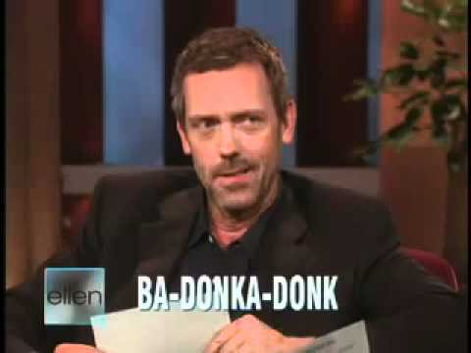
Word Choice...Author’s Craft…
Brush Strokes...
Right-side:
2. Brainstorm a list of appositives to rename Hugh Laurie or Ellen Degeneres. Then, describe the video using one appositive in a sentence.
Appositives

Slide 5
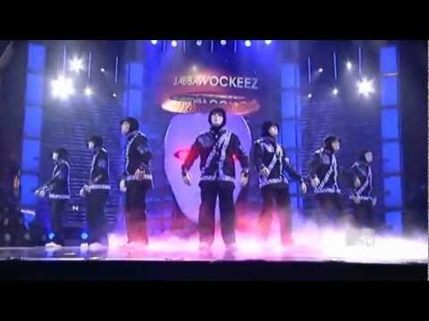
Word Choice...Author’s Craft…
Brush Strokes...
Right-side:
3. Brainstorm a list of appositives...Then, describe the video using one appositive in a sentence.
Appositives

Slide 6
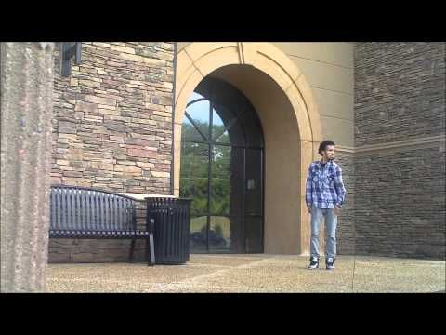
Word Choice...Author’s Craft…
Brush Strokes...
Reft-side:
4. Brainstorm a list of appositives...Then, describe the video using one appositive in a sentence.
Appositives

Slide 7
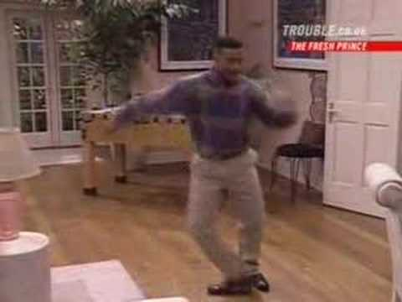
Word Choice...Author’s Craft…
Brush Strokes...
Quiz Time!
Appositives

