Slide 1
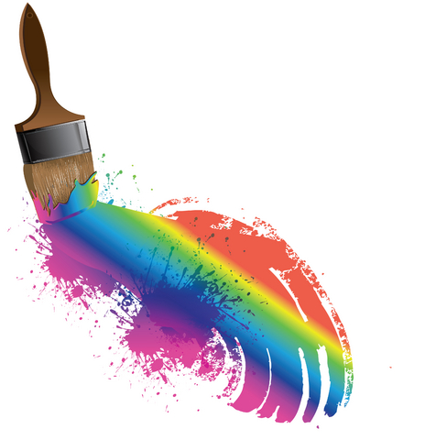
Word Choice...Author’s Craft…
Brush Strokes...
Describe the video using two absolutes either at the beginning or ending of your sentence.
Right-side Title
Absolutes

Slide 2
Word Choice...Author’s Craft…
Brush Strokes...
2. Describe the video using two absolutes either at the beginning or ending of your sentence.
Absolutes

Slide 3
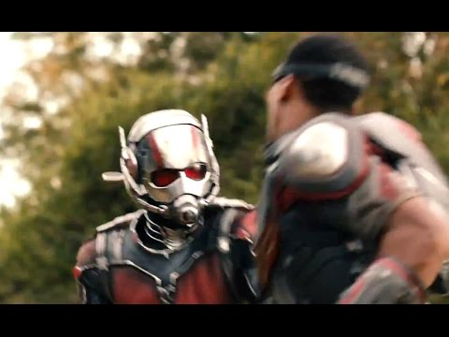
Word Choice...Author’s Craft…
Brush Strokes...
3. Describe the video using two absolutes either at the beginning or ending of your sentence.
Absolutes

Slide 4
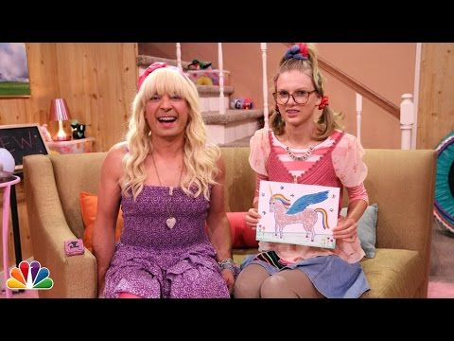
Word Choice...Author’s Craft…
Brush Strokes...
4. Describe the video using two absolutes either at the beginning or ending of your sentence.
Absolutes

Slide 5
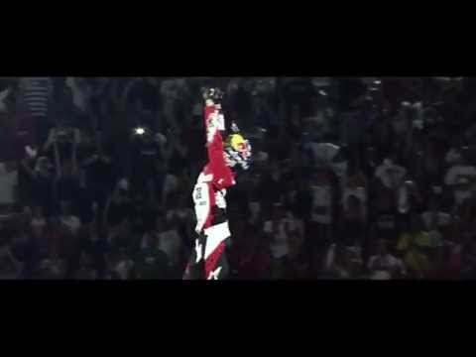
Word Choice...Author’s Craft…
Brush Strokes...
Quiz
Create a sentence by describing the video using two absolutes.
What is an absolute?
Why should you use an absolute?
Where should an absolute never be placed?
Absolutes

